Slide 1


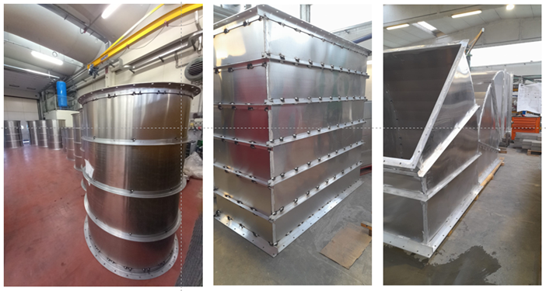


PROMETHEUS METAL
Industrial Fabrication & Welding Solutions
Buzău, Romania
Company presentation
Part of the PROFIREPROOFING Group
2021
Buzău
Welded fabrication
Founded
Registered in
Core offer
PROMETHEUS METAL
PROFIREPROOFING

Slide 2
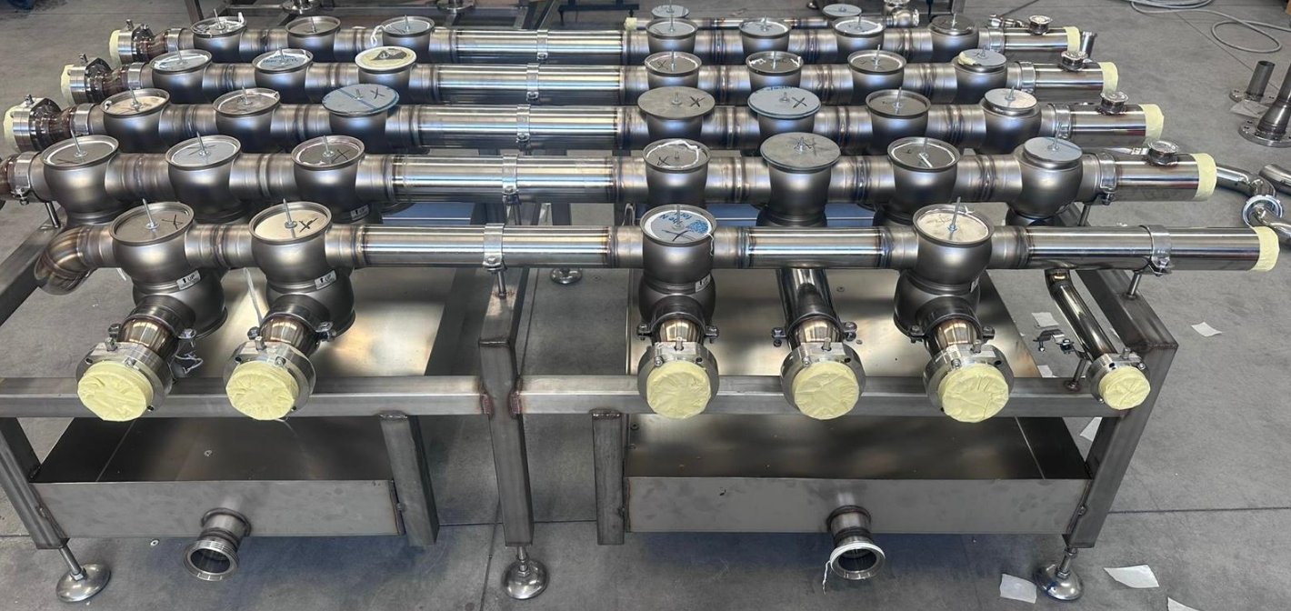
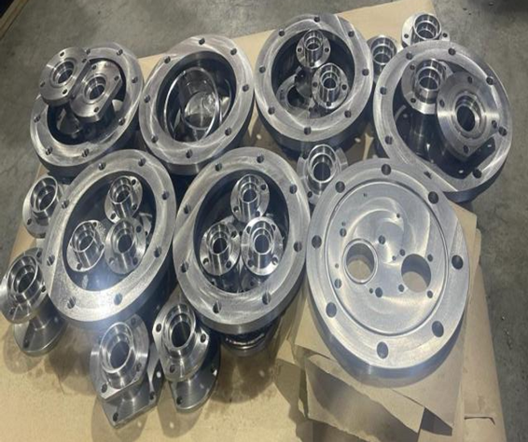
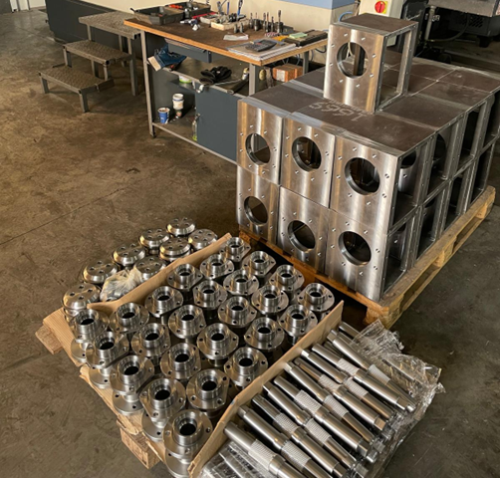
Company Overview
A compact fabrication partner for custom metal work
Romanian privately owned company focused on welded assemblies, fabricated parts and steel structures.
PROMETHEUS METAL SRL is a Romanian company established in 2021, part of Prometheus (Italy), and registered with the Buzău Trade Register under no. J10/1224/2021, fiscal code RO44945340.
What we manufacture
Welded structural assemblies and subassemblies
Parts for civil and industrial machinery
Metal and steel structures
Fabricated manifold assembly
Machined flanges and fittings
Main sectors
Oil & gas
Industrial automation
Industrial machinery
Mechanical processing parts
Stainless steel tank work

Slide 3
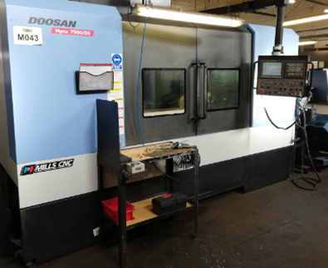
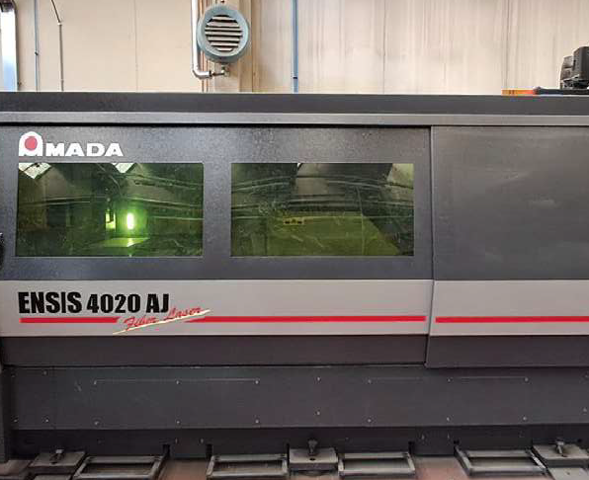
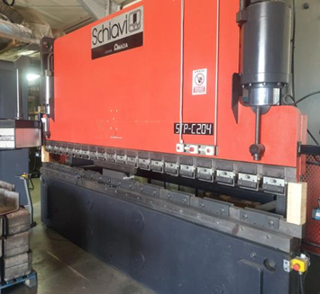
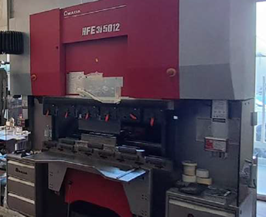
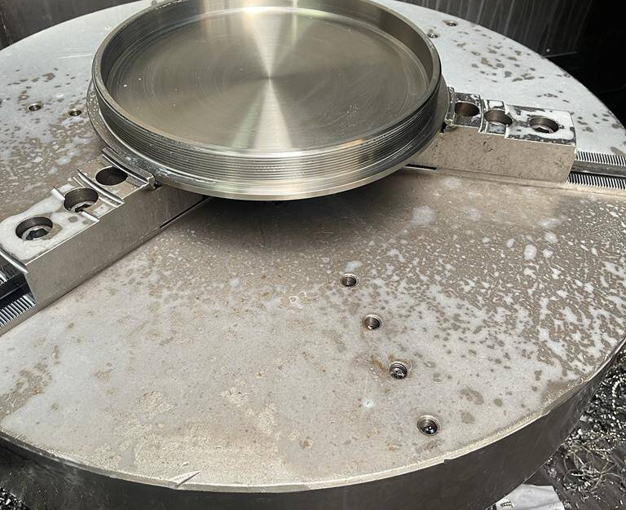
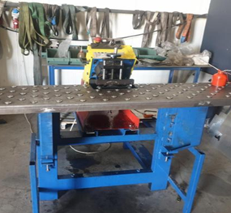
Production Capability
Core production capabilities
Selected in-house equipment and operations shown in the original presentation.
Main equipment
Amada laser cutting system
Schiavi Amada bending machine – 200 tons
Schiavi Amada bending machine – 50 tons
Bending up to 1,270 mm length / 5 mm thickness
CNC vertical milling
Plate chamfering machine (GBC)
Bench chamfering machine for aluminium
50-ton press
Vertical drilling machine
CNC vertical milling
Amada laser cutting
200 t press brake
50 t press brake
Plate chamfering
Bench chamfering

Slide 4
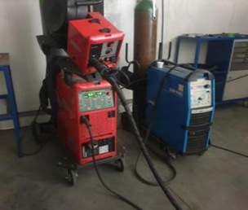
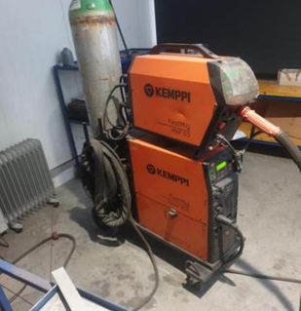
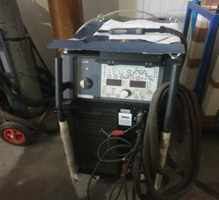
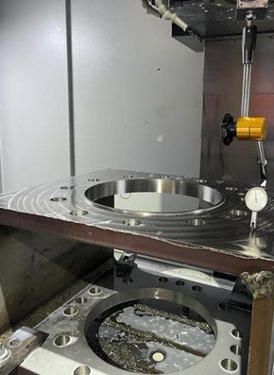
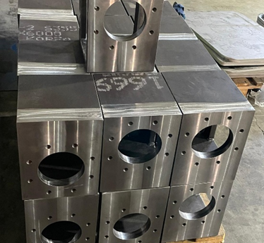
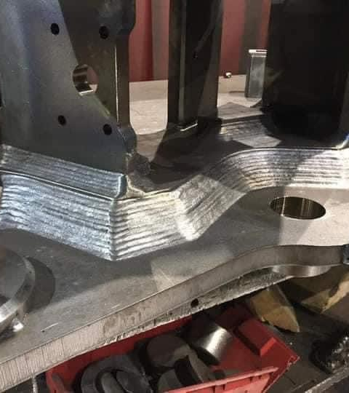
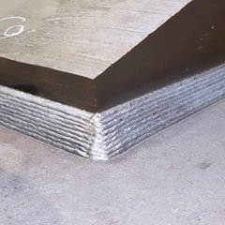
Fabrication & Welding
Welding, processing and shop-floor support
Capabilities relevant to subcontract fabrication, pipe-related components and general welded assemblies.
Shop support and welding assets
MIG/MAG welding equipment
Vertical drilling machine
Magnetic drilling machine
Band saw (MACC)
1,500 kg Linde forklift
500 kg slewing jib crane
Hand tools for grinding and drilling
Welder qualifications listed for ISO 9606-1 and ISO 9606-2 processes
MIG/MAG welding
Welding source
Drilling equipment
Vertical machining
Materials shown
Carbon steel
Stainless steel
Aluminium
Processed steel part
Weld detail
Layered weld build-up

Slide 5
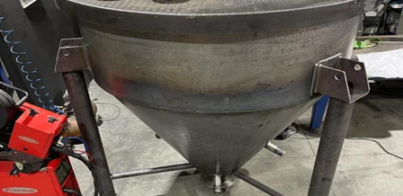
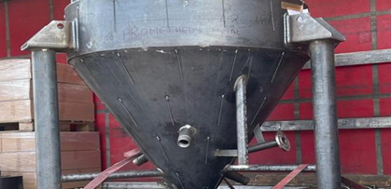
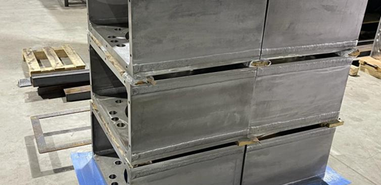
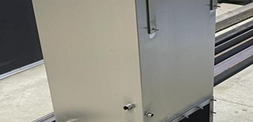
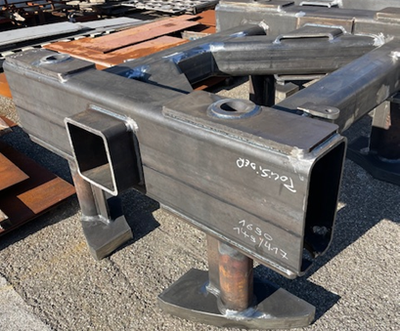
Products
Examples of delivered products
The original deck shows a broad mix of ducting, tanks, boxes, machined parts and fabricated steel components.
Duct / hopper fabrication
Small tank
Stainless steel boxes
Reservoir / cabinet
Flanges and fittings
Steel structure element

Slide 6
Why Prometheus Metal
Positioning for customer and subcontract work
A concise closing slide that helps the presentation read like a commercial document, not only a machine list.
Custom welded assemblies and fabricated parts
Coverage across carbon steel, stainless steel and aluminium work shown in the source deck
In-house cutting, bending, machining, chamfering and welding assets
Useful profile for industrial subcontracting, fabricated components and short-run custom work
Structured quality section with ISO management certifications and listed welder qualifications
Stainless fabrication
Complex assembly
Welded structure
Machined parts

Slide 7
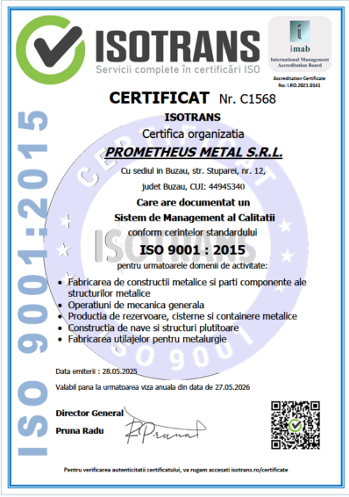
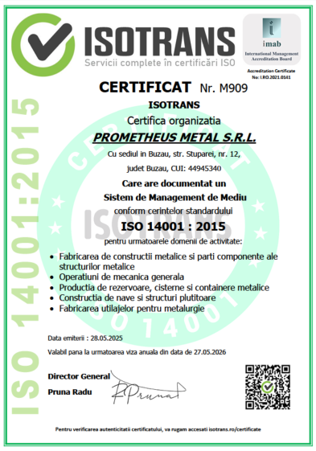
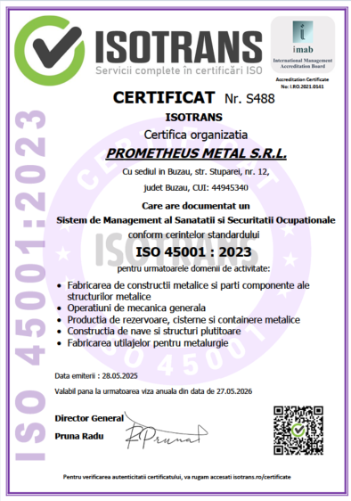




Quality & Certification
Quality certifications and welding qualifications
Reformatted from the source presentation for easier review by buyers and quality teams.
Management system certifications
ISO 9001 – applicable edition
ISO 14001 – applicable edition
ISO 45001 – applicable edition
Welder qualifications listed
ISO 9606-2:2006 – 131, 141.
ISO 9606-1:2017 – 141, 135, 136, 138.

Slide 8
Thank you
Prometheus Metal SRL
Buzău, Romania
A cleaner version of the original company deck, prepared for client-facing use.

